Slide 1
30 maart 2019 #GIB2019
Gijs in ‘t Veld
Voorzitter/Chairman MIUG

Slide 2

Thank you for sponsoring and hosting!

Slide 3
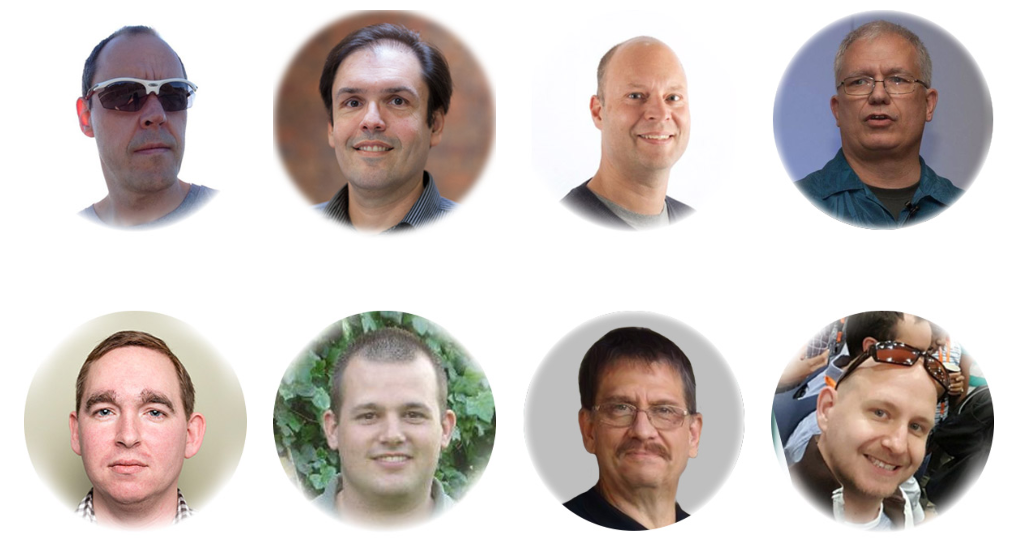
Global Organizers

Slide 4
Global Integration Bootcamp 2019 - Agenda
9:00 Welkom - Gijs in 't Veld
9:15 Azure's Cloud platform: Building serverless applications - Eldert Grootenboer
10:00 Labs
11:15 A better understanding of Azure Functions – Steef-Jan Wiggers
12:00 Lunch en labs
14:00 Microsoft Azure Integration and Governance - Under the Hood – Nino Crudele
14:45 Labs
16:00 Building microservices with .NET Core and Azure Kubernetes Service (AKS) - Tomasso Groenendijk
17:00 Hapjes en drankje
Twitter #GIB2019

Slide 5
#MIUGNL @MIUGNL MIUG.NL
Gijs in ‘t Veld @gintveld
Steef-Jan Wiggers @steefjan
Tomasso Groenendijk @tlagroenendijk
Lex Hegt @lexhegt
Roger Busser

Slide 6


Azure’s Cloud Platform Building serverless applications
Eldert Grootenboer
Cloud Solution Architect

Slide 7



Eldert Grootenboer
@egrootenboer
Notes:
Cloud Solution Architect
Microsoft Azure MVP
SME IoT
International Speaker
Blogger
Global Integration Bootcamp
Azure IoT Community
Published Author
InfoQ
Boat enthusiast

Slide 8
Defining Serverless
“Serverless computing is a cloud-computing execution model in which the cloud provider dynamically manages the allocation of machine resources. Pricing is based on the actual amount of resources consumed by an application, rather than on pre-purchased units of capacity. It is a form of utility computing.”
Source (Wikipedia Serverless Computing): https://en.wikipedia.org/wiki/Serverless_computing
Notes:
Abstraction of servers & platforms, event driven, event scale, micro-billing, DevOps productivity, focus on business logic, faster time to market!

Slide 9
Evolution to Serverless

Slide 10
What is the right size of
servers for my business needs?
How do I deploy new code to my server?
What media should I
use to keep backup?
What happens in case of
server hardware failure?
Which packages should be on my server?
What size of servers
should I buy?
Who monitors
my App?
How often should I backup my server?
How can I scale my app?
How can I increase server utilization?
Who has physical
access to my servers?
Which OS should I use?
Do I need secondary network connection?
Are my server in a
secure location?
What happens if the
power goes out?
Who monitors
my Servers?
Do I need a UPS?
What storage I need to use?
How many servers
do I need?
How can I dynamically configure my app?
It takes how long to provision a new server?
How often should
I patch my servers?
On-Premises

Slide 11
What is the right size of servers for my business needs?
How can I increase server utilization?
How many servers do I need?
How can I scale my app?
How often should I patch my servers?
How do I deploy new code to my server?
How often should I backup my server?
Which OS should I use?
Which packages should be on my server?
Who monitors my App?
On-Premises
IaaS

Slide 12
What is the right size of tier for my business needs?
How can I increase resources utilization?
How many resources do I need?
How can I scale my app?
On-Premises
IaaS
PaaS

Slide 13
How do I architect my app?
Serverless, the platform for next gen apps
On-Premises
IaaS
PaaS
Serverless

Slide 14
What is “Serverless”
Abstraction of servers
Event-driven scale
Sub-second billing

Slide 15
Azure Serverless
versus
PaaS
Compute
Workflow
Events
Database
Realtime
IoT
Messaging
Analytics

Slide 16
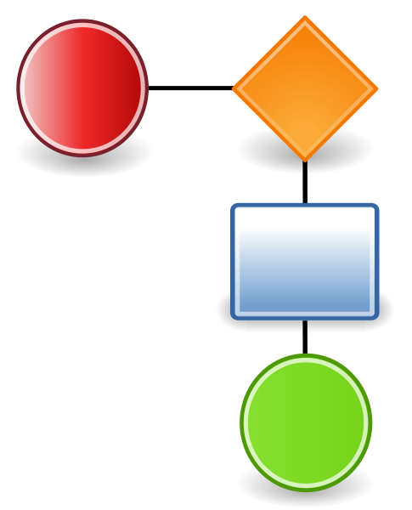

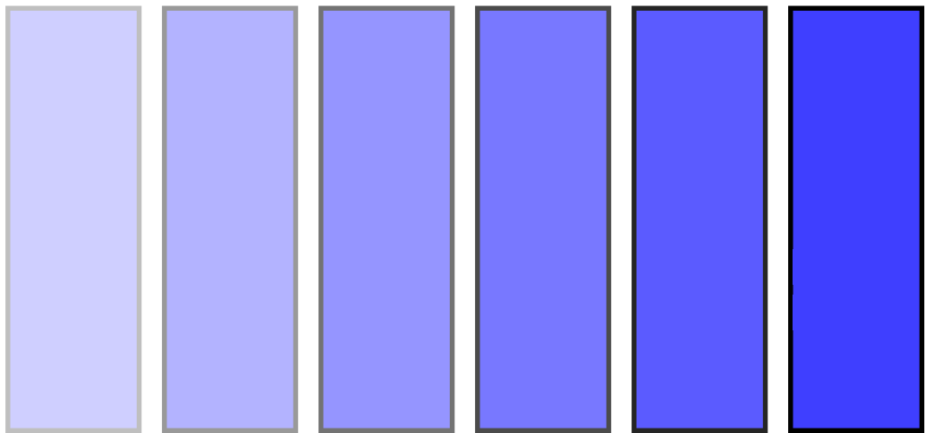
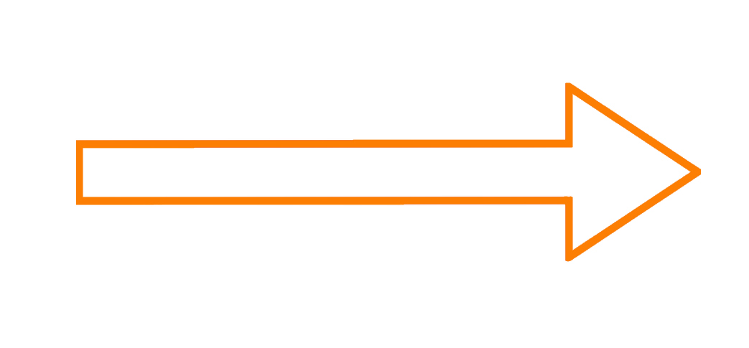
Cloud Trinity
Workflow
Compute
Eventing

Slide 17
Workflow

Slide 18
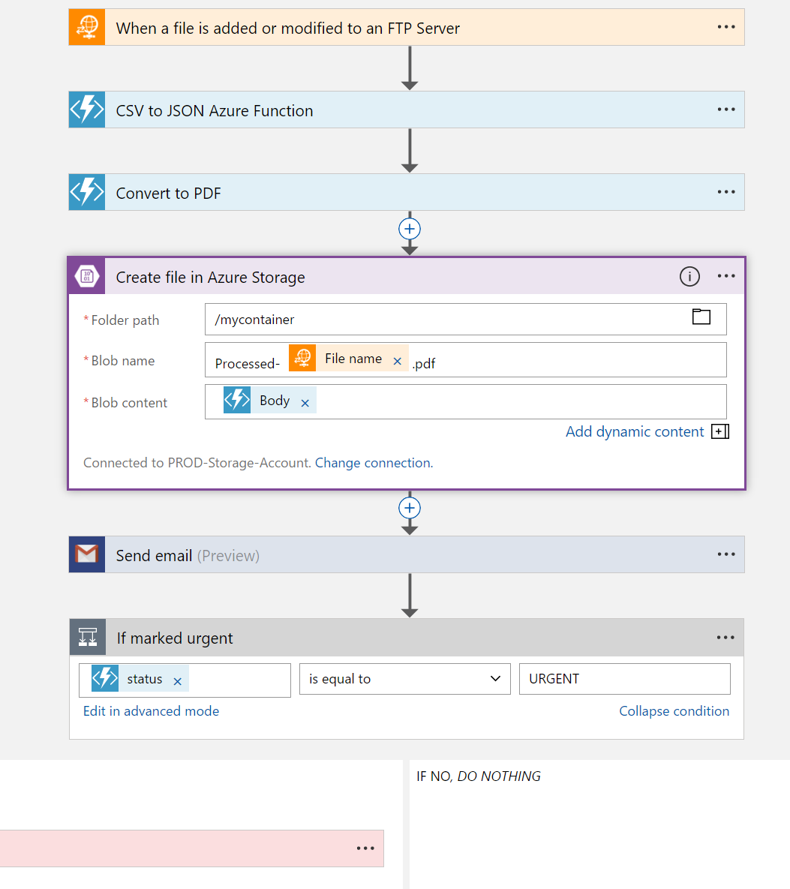
Logic Apps
Visual Designer
Workflow, triggers and actions
Applications, data and services
Enterprise Integration
Create, deploy, manage and monitor
Notes:
Faster integration using innovative Visual Designer
Easy workflow creation with triggers and actions
Mashup applications, data and services
Built for mission critical Enterprise Integration
Create, deploy, manage and monitor

Slide 19
Connected
Cloud APIs and platform functionality
Nearly 200 OOTB connectors
Hosted and managed
Scalable
Rapid development
API connections
Authenticate once and reuse
Simple to deploy
Easily manageable

Slide 20
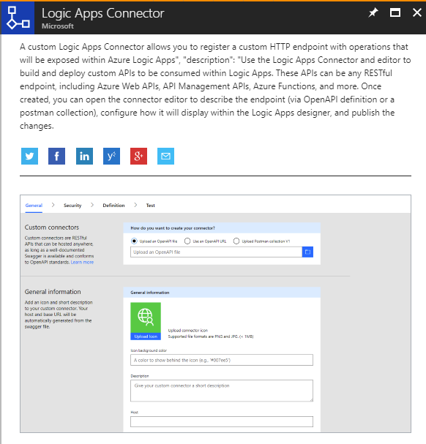
Custom Connectors

Slide 21
Monitoring & Tracking
Trigger & Run History
Monitoring view
Diagnostics
Alerts
Tracked properties

Slide 22
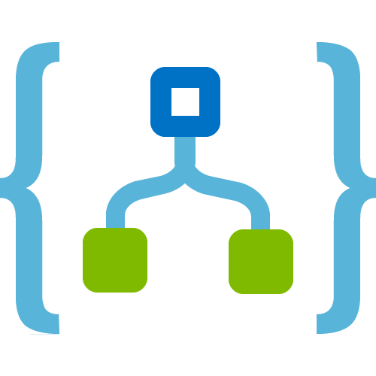










Hybrid Integration
On-premises Data Gateway
Azure API
Management
Azure Service Bus
Logic Apps
Logic Apps
Logic Apps
GatewayCloud Service
APIM
Azure Service Bus relay
Virtual network or public
Queues
Topics
Gateway
Data Sources
LOB
Systems
SOAP web services
Backend
APIs
API-based
Notes:
Without opening firewall

Slide 23





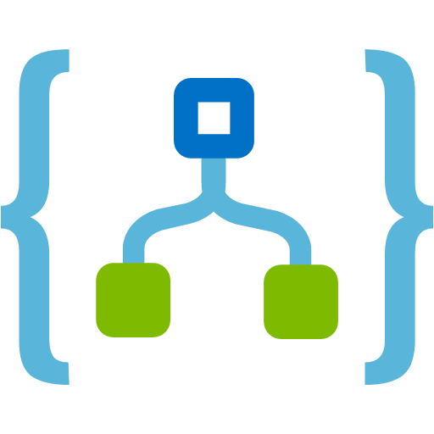
Demo – Onboarding Process

Slide 24
Compute

Slide 25








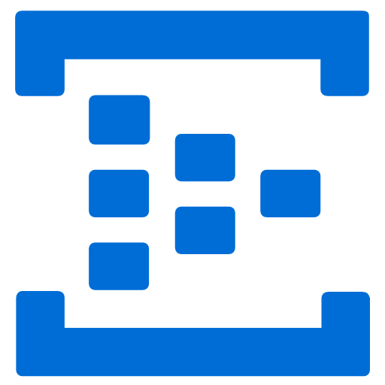
Azure Functions
Events
Code
Outputs
React to timers, HTTP, or events from your favorite Azure services, with more on the way
Author functions in C#, F#, Node.JS, Java, and more
Send results to an ever-growing collection of services

Slide 26
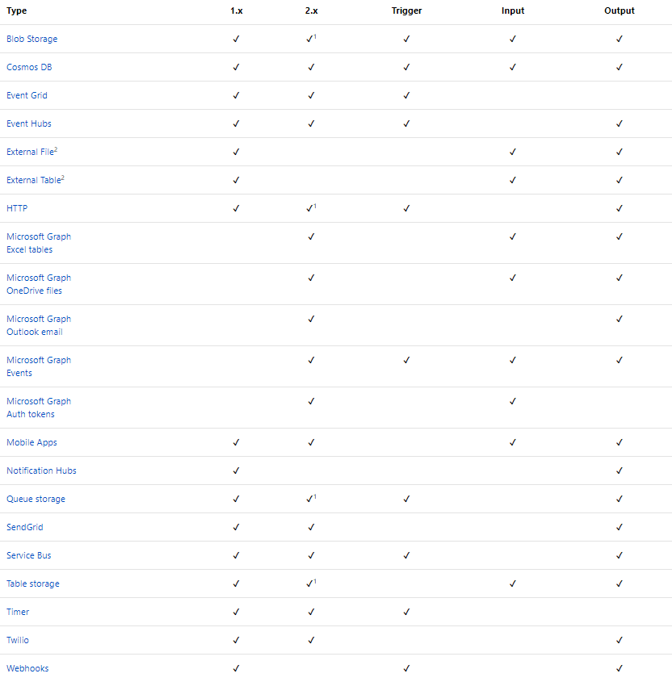
Functions Triggers and Bindings

Slide 27
Function bindings
Provides low-code access to many external sources
23 bindings
Ideal for “data-in, data-out” scenarios

Slide 28





Demo – PGP Decryption

Slide 29
Eventing

Slide 30
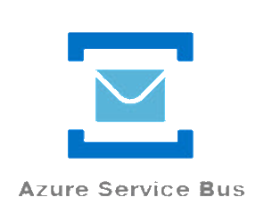
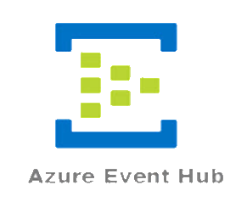
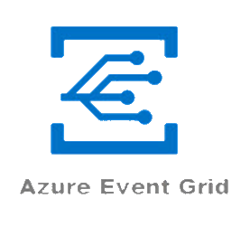
Service Bus Services
Messaging
Transactions
Control
Pull
Series Events
Telemetry
Streaming
Discrete Events
Event Handling
Reactive
Push

Slide 31
Azure Event Grid
Fully-managed event routing
Near real-time event delivery at scale
Broad coverage within Azure and beyond
Backbone of event-driven computing
Notes:
Sub-second end-to-end latency in the 99th percentile
10,000,000 events per second per region
24-hour retry with exponential back off for events not delivered
OOTB Publishers + Custom Capabilities
Here are some of the key features of Azure Event Grid:
Simplicity - Point and click to aim events from your Azure resource to any event handler or endpoint.
Advanced filtering - Filter on event type or event publish path to ensure event handlers only receive relevant events.
Fan-out - Subscribe multiple endpoints to the same event to send copies of the event to as many places as needed.
Reliability - Utilize 24-hour retry with exponential backoff to ensure events are delivered.
Pay-per-event - Pay only for the amount you use Event Grid.
High throughput - Build high-volume workloads on Event Grid with support for millions of events per second.
Built-in Events - Get up and running quickly with resource-defined built-in events.
Custom Events - use Event Grid route, filter, and reliably deliver custom events in your app.

Slide 32
Benefits
Focus on innovation and pay per event
Ensure reliability and performance for your apps
Unlock new scenarios for your apps
Manage all events in one place
Notes:
Tord Glad Nordahl : “With dynamic scale and consistent performance Azure Event grid lets you focus on your app logic rather than the infrastructure around it."

Slide 33
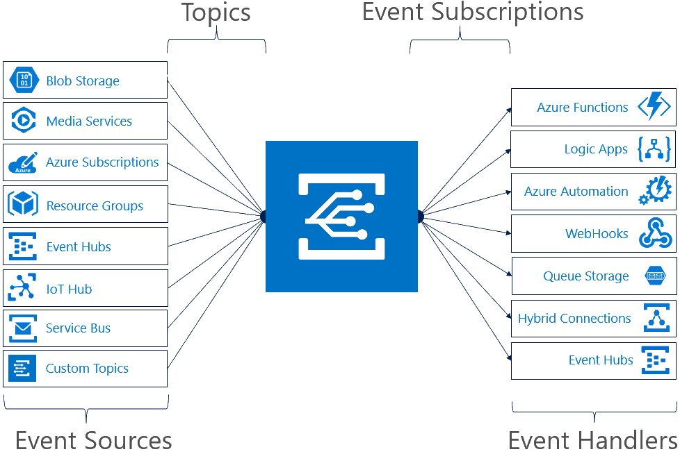
Concepts
Events: what happened
Event Publishers: where it took place
Topics: where publishers send events
Event Subscriptions: how you receive events
Event Handlers: the app or service reacting to the event

Slide 34
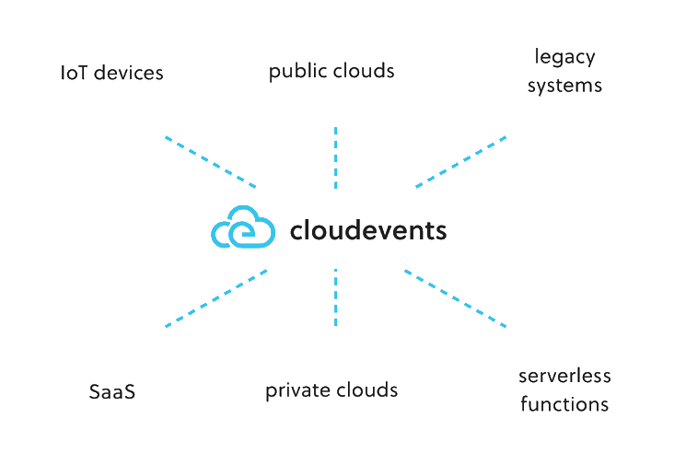
CloudEvents

Slide 35
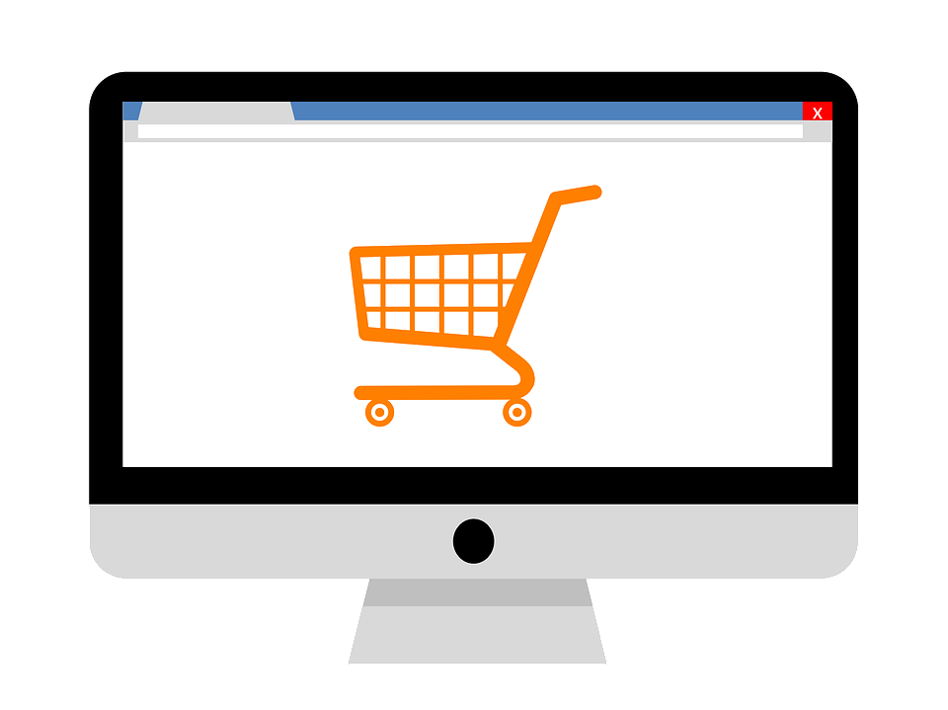


Demo – Eventing

Slide 36
Bringing it all Together

Slide 37

Azure Serverless Components
Event Grid
Logic Apps
Functions
Manage all events that can trigger code or logic
Design workflows and orchestrate processes
Execute your code based on events you specify

Slide 38

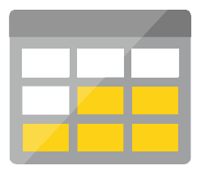

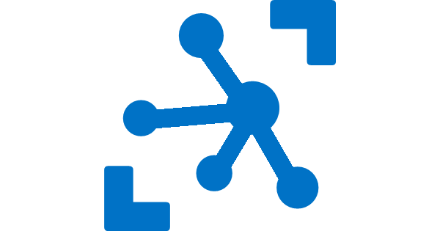


Azure Serverless Components
Platform
Event Grid
Logic Apps
Functions
Manage all events that can trigger code or logic
Design workflows and orchestrate processes
Execute your code based on events you specify
Database
Storage
Security
IoT
Analytics
Intelligence

Slide 39

Azure Serverless Components
Development
Platform
IDE support
Event Grid
Logic Apps
Functions
Manage all events that can trigger code or logic
Design workflows and orchestrate processes
Execute your code based on events you specify
Integrated DevOps
Local Development
Monitoring
Database
Storage
Security
IoT
Analytics
Intelligence
Visual Debug History

Slide 40



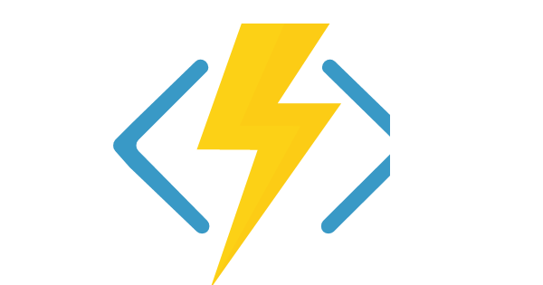
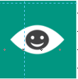

Better Together
Limitless Possibilities

Slide 41
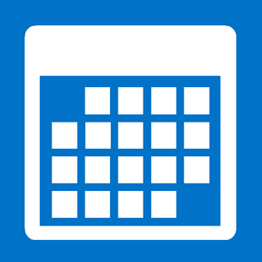


Demo – Order System

Slide 42
Almost done…

Slide 43
Key Takeaways
Serverless
Focus on value
Cost Efficient
Only pay for what you use
Better Together
Combine services to create powerful scenarios

Slide 44



Thank You
@egrootenboer
eldert@eldert.net
https://blog.eldert.net/

Slide 45




Think
Share
Move

